Slide 1
Practice MCQs
Session-2

Slide 2
Q1
A. Base
Derived
Derived
B. Base
Base
Derived
C. Base
Derived
Base
D. Compiler Error
Output of following Java program?
class Base {
public void Print() {
System.out.println("Base");
}
}
class Derived extends Base {
public void Print() {
System.out.println("Derived");
}
}
class Main{
public static void DoPrint( Base o ) {
o.Print();
}
public static void main(String[] args) {
Base x = new Base();
Base y = new Derived();
Derived z = new Derived();
DoPrint(x);
DoPrint(y);
DoPrint(z);
}
}

Slide 3
Q1
A. Base
Derived
Derived
B. Base
Base
Derived
C. Base
Derived
Base
D. Compiler Error
Output of following Java program?
class Base {
public void Print() {
System.out.println("Base");
}
}
class Derived extends Base {
public void Print() {
System.out.println("Derived");
}
}
class Main{
public static void DoPrint( Base o ) {
o.Print();
}
public static void main(String[] args) {
Base x = new Base();
Base y = new Derived();
Derived z = new Derived();
DoPrint(x);
DoPrint(y);
DoPrint(z);
}
}

Slide 4
Q2
Which of the following is/are true about constructors in Java?
1) Constructor name should be same as class name.
2) If you don't define a constructor for a class,
a default parameterless constructor is automatically
created by the compiler.
3) The default constructor calls super() and initializes all
instance variables to default value like 0, null.
4) If we want to parent class constructor, it must be called in
first line of constructor.
A.1
B.1, 2
C.1, 2 and 3
D.1, 2, 3 and 4

Slide 5
Q2
Which of the following is/are true about constructors in Java?
1) Constructor name should be same as class name.
2) If you don't define a constructor for a class,
a default parameterless constructor is automatically
created by the compiler.
3) The default constructor calls super() and initializes all
instance variables to default value like 0, null.
4) If we want to parent class constructor, it must be called in
first line of constructor.
A.1
B.1, 2
C.1, 2 and 3
D.1, 2, 3 and 4

Slide 6
Q3
Predict the output of following Java program
class T {
int t = 20;
T() {
t = 40;
}
}
class Main {
public static void main(String args[]) {
T t1 = new T();
System.out.println(t1.t);
}
}
A. 20
B. 40
C. Compiler Error
D. Runtime Error

Slide 7
Q3
Predict the output of following Java program
class T {
int t = 20;
T() {
t = 40;
}
}
class Main {
public static void main(String args[]) {
T t1 = new T();
System.out.println(t1.t);
}
}
A. 20
B. 40
C. Compiler Error
D. Runtime Error

Slide 8
Q4
What will be the output of following code?
class Test
{
void myMethod()
{
System.out.println(“ABC");
}
}
public class Derived extends Test
{
void myMethod()
{
System.out.println(“PQR");
}
public static void main(String[] args)
{
Derived object = new Test();
object.myMethod();
}
}
a) ABC
b) PQR
c) Compilation error
d) Runtime error

Slide 9
Q4
What will be the output of following code?
class Test
{
void myMethod()
{
System.out.println(“ABC");
}
}
public class Derived extends Test
{
void myMethod()
{
System.out.println(“PQR");
}
public static void main(String[] args)
{
Derived object = new Test();
object.myMethod();
}
}
a) ABC
b) PQR
c) Compilation error
d) Runtime error

Slide 10
Q5
Output??
class Derived
{
public void getDetails(String temp)
{
System.out.println("Derived class " + temp);
}
}
public class Test extends Derived
{
public int getDetails(String temp)
{
System.out.println("Test class " + temp);
return 0;
}
public static void main(String[] args)
{
Test obj = new Test();
obj.getDetails("ABC");
}
}
a) Derived class ABC
b) Test class ABC
c) Compilation error
d) Runtime error

Slide 11
Q5
Output??
class Derived
{
public void getDetails(String temp)
{
System.out.println("Derived class " + temp);
}
}
public class Test extends Derived
{
public int getDetails(String temp)
{
System.out.println("Test class " + temp);
return 0;
}
public static void main(String[] args)
{
Test obj = new Test();
obj.getDetails("ABC");
}
}
a) Derived class ABC
b) Test class ABC
c) Compilation error
d) Runtime error

Slide 12
Q6
Which of the following is FALSE about arrays on Java
A. A java array is always an object
B. Length of array can be changed after creation of array
C. Arrays in Java are always allocated on heap
D. Both A & B

Slide 13
Q6
Which of the following is FALSE about arrays on Java
A. A java array is always an object
B. Length of array can be changed after creation of array
C. Arrays in Java are always allocated on heap
D. Both A & B

Slide 14
Q7
public class Test
{
public int getData() //getdata() 1
{
return 0;
}
public long getData() //getdata 2
{
return 1;
}
public static void main(String[] args)
{
Test obj = new Test();
System.out.println(obj.getData());
}
}
a) 1 b) 0 c) Runtime error d) Compilation error

Slide 15
Q7
public class Test
{
public int getData() //getdata() 1
{
return 0;
}
public long getData() //getdata 2
{
return 1;
}
public static void main(String[] args)
{
Test obj = new Test();
System.out.println(obj.getData());
}
}
a) 1 b) 0 c) Runtime error d) Compilation error

Slide 16
Q8
public class Main
{
private String function(float i, int f)
{
return ("ABC");
}
private String function(double i, double f)
{
return ("PQR");
}
public static void main(String[] args)
{
Main obj = new Main();
System.out.println(obj.function(1.2, 20));
}
}
a) ABC b) Compilation error c) Runtime error d) PQR

Slide 17
Q8
public class Main
{
private String function(float i, int f)
{
return ("ABC");
}
private String function(double i, double f)
{
return ("PQR");
}
public static void main(String[] args)
{
Main obj = new Main();
System.out.println(obj.function(1.2, 20));
}
}
a) ABC b) Compilation error c) Runtime error d) PQR

Slide 18
Q9
What will be the output of following code?
class Test1 {
int p=2;
}
class Test2 extends Test1 {
int q=3;
}
public class CA {
public static void main(String[] args)
{
Test1 obj = new Test2();
System.out.println(obj.p+obj.q);
}
}
5
Compile time error
2
Runtime error

Slide 19
Q9
What will be the output of following code?
class Test1 {
int p=2;
}
class Test2 extends Test1 {
int q=3;
}
public class CA {
public static void main(String[] args)
{
Test1 obj = new Test2();
System.out.println(obj.p+obj.q);
}
}
5
Compile time error
2
Runtime error

Slide 20
Q10
What will be the output of following code?
interface Test
{
boolean check(int p,int q);
}
public class Test{
public static void main(String args[])
{
Test ref=(n1,n2)->n1*2+n2==n1*n2;
System.out.println(ref.check(5,10));
}
}
true
false
Compile time error
Runtime error

Slide 21
Q10
What will be the output of following code?
interface Test
{
boolean check(int p,int q);
}
public class Test{
public static void main(String args[])
{
Test ref=(n1,n2)->n1*2+n2==n1*n2;
System.out.println(ref.check(5,10));
}
}
true
false
Compile time error
Runtime error

Slide 22
Q11
What will be the output of following code?
@FunctionalInterface
interface Test
{
int A(int a,int b);
static String show()
{
return "Hello";
}
}
public class CA{
public static void main(String args[])
{
Test ref=(p,q)->p+q;
System.out.println(ref.A(1,2)+" "+Test.show());
}
}
Compile time error
3 Hello
Runtime error
Hello

Slide 23
Q11
What will be the output of following code?
@FunctionalInterface
interface Test
{
int A(int a,int b);
static String show()
{
return "Hello";
}
}
public class CA{
public static void main(String args[])
{
Test ref=(p,q)->p+q;
System.out.println(ref.A(1,2)+" "+Test.show());
}
}
Compile time error
3 Hello
Runtime error
Hello

Slide 24
Q12
What will be the output of following code?
@FunctionalInterface
interface Test1
{
int A(int a);
}
@FunctionalInterface
interface Test2
{
int B(int b);
}
@FunctionalInterface
interface Test3
{
int C();
}
public class Test{
public static void main(String args[])
{
Test1 ref1=(n1)->n1*n1;
Test2 ref2=(n2)->n2*2;
Test3 ref3=()->{return ref1.A(2)+ref2.B(3);};
System.out.println(ref3.C());
}
}
10
Compile time error
Runtime error
0

Slide 25
Q12
What will be the output of following code?
@FunctionalInterface
interface Test1
{
int A(int a);
}
@FunctionalInterface
interface Test2
{
int B(int b);
}
@FunctionalInterface
interface Test3
{
int C();
}
public class Test{
public static void main(String args[])
{
Test1 ref1=(n1)->n1*n1;
Test2 ref2=(n2)->n2*2;
Test3 ref3=()->{return ref1.A(2)+ref2.B(3);};
System.out.println(ref3.C());
}
}
10
Compile time error
Runtime error
0

Slide 26
Q13
What will be the output of following code?
@FunctionalInterface
interface Test1
{
int A(int a,int b);
}
public class CA{
public static void main(String args[])
{
Test1 ref1=(n1,n2)->{
return n1+2>n2-2?100:200;
};
System.out.println(ref1.A(1,5));
}
}
100
200
Compile time error
Runtime error

Slide 27
Q13
What will be the output of following code?
@FunctionalInterface
interface Test1
{
int A(int a,int b);
}
public class CA{
public static void main(String args[])
{
Test1 ref1=(n1,n2)->{
return n1+2>n2-2?100:200;
};
System.out.println(ref1.A(1,5));
}
}
100
200
Compile time error
Runtime error

Slide 28
Q14
What is the process of defining more than one method in a class differentiated by parameters?
Method overriding
Method overloading
Method chaining
None of the mentioned

Slide 29
Q14
What is the process of defining more than one method in a class differentiated by parameters?
Method overriding
Method overloading
Method chaining
None of the mentioned

Slide 30
Q15
Predict the output?
class Main
{
public static void main(String args[])
{
int arr[] = new int[] {0 , 1, 2, 3, 4, 5, 6, 7, 8, 9};
int n = 4;
n = arr[arr[n+1] / 2];
System.out.println(arr[n+1] % 3);
}
}
a) 3
b) 0
c) 6
d) 1

Slide 31
Q15
Predict the output?
class Main
{
public static void main(String args[])
{
int arr[] = new int[] {0 , 1, 2, 3, 4, 5, 6, 7, 8, 9};
int n = 4;
n = arr[arr[n+1] / 2];
System.out.println(arr[n+1] % 3);
}
}
a) 3
b) 0
c) 6
d) 1

Slide 32
Q16
What will be the output of the following Java code?
enum Season
{
WINTER, SPRING, SUMMER, FALL
};
class Main
{
public static void main (String[] args)
{
System.out.println(Season.FALL.ordinal());
}
}
a) 0
b) 1
c) 2
d) 3

Slide 33
Q16
What will be the output of the following Java code?
enum Season
{
WINTER, SPRING, SUMMER, FALL
};
class Main
{
public static void main (String[] args)
{
System.out.println(Season.FALL.ordinal());
}
}
a) 0
b) 1
c) 2
d) 3

Slide 34
Q17
What is the output of the following code?
class Test {
public static void main(String[] args) {
for(int i = 0; 1; i++) {
System.out.println("Hello");
break;
}
}
}
a. Hello
b. Hello will be printed infinite time
c. Compile time error
d. None of these.

Slide 35
Q17
What is the output of the following code?
class Test {
public static void main(String[] args) {
for(int i = 0; 1; i++) {
System.out.println("Hello");
break;
}
}
}
a. Hello
b. Hello will be printed infinite time
c. Compile time error
d. None of these.

Slide 36
Q18
What will be the output of following code?
public class Test
{
public static void main(String[] args)
{
short x=45;
byte y=x;
System.out.println(y);
}
}
45
0
Compile time error
-1

Slide 37
Q18
What will be the output of following code?
public class Test
{
public static void main(String[] args)
{
short x=45;
byte y=x;
System.out.println(y);
}
}
45
0
Compile time error
-1

Slide 38
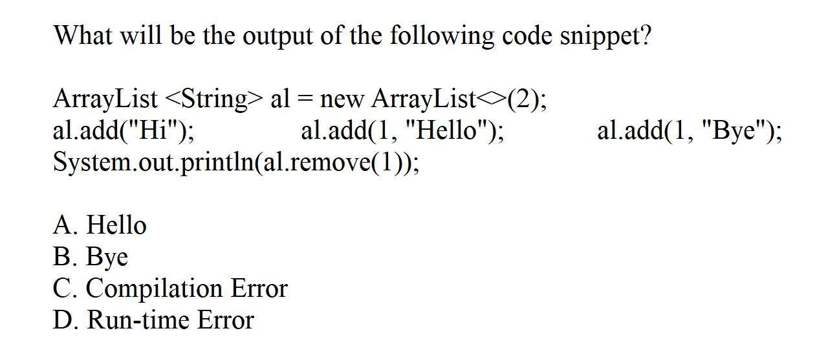
Q19

Slide 39
Q19
B

Slide 40
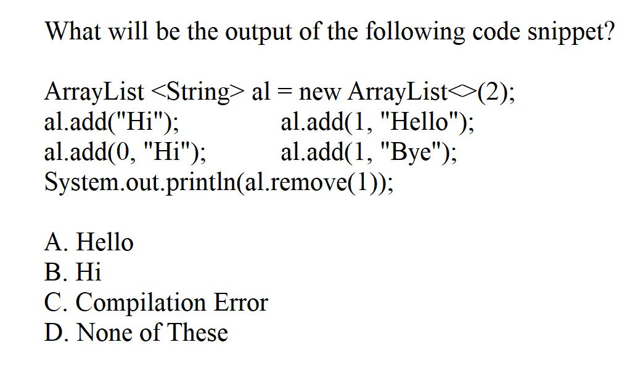
Q20

Slide 41
Q20
D

Slide 42
Q21
What will be the output of following code?
class Evaluation
{
void task()
{
class Test_local
{
static final int a=100;
int value()
{
return a;
}
}
Test_local obj=new Test_local();
System.out.println(obj.value());
}
}
public class Task
{
public static void main(String[] args)
{
Evaluation ref=new Evaluation();
ref.task();
}
}
100
0
Compile time error
Runtime error

Slide 43
Q21
What will be the output of following code?
class Evaluation
{
void task()
{
class Test_local
{
static final int a=100;
int value()
{
return a;
}
}
Test_local obj=new Test_local();
System.out.println(obj.value());
}
}
public class Task
{
public static void main(String[] args)
{
Evaluation ref=new Evaluation();
ref.task();
}
}
100
0
Compile time error
Runtime error

Slide 44
Q22
What will be the output of following code?
abstract class Test
{
static int x=1,y=2;
abstract void show();
static int result()
{
return x*y;
}
}
public class Task
{
public static void main(String[] args)
{
Test ref = new Test()
{
void show()
{
System.out.println(Test.result());
}
};
ref.show();
}
}
Compile time error
Runtime error
2
0

Slide 45
Q22
What will be the output of following code?
abstract class Test
{
static int x=1,y=2;
abstract void show();
static int result()
{
return x*y;
}
}
public class Task
{
public static void main(String[] args)
{
Test ref = new Test()
{
void show()
{
System.out.println(Test.result());
}
};
ref.show();
}
}
Compile time error
Runtime error
2
0

Slide 46
Q23
What will be the output of following code?
interface Test
{
void show1();
void show2();
}
public class Task
{
public static void main(String[] args)
{
Test obj = new Test()
{
public void show1()
{
System.out.println(“Hello");
}
};
obj.show1();
}
}
Hello
Compile time error
Runtime error
Blank Output

Slide 47
Q23
What will be the output of following code?
interface Test
{
void show1();
void show2();
}
public class Task
{
public static void main(String[] args)
{
Test obj = new Test()
{
public void show1()
{
System.out.println(“Hello");
}
};
obj.show1();
}
}
CA2
Compile time error
Runtime error
Blank Output

Slide 48
Q24
import java.util.*;
public class Main {
public static void main(String[] args)
{
TreeSet<String> treeSet = new TreeSet<>();
treeSet.add(“B");
treeSet.add(“A");
treeSet.add(“D");
treeSet.add(“C");
for (String temp : treeSet)
System.out.printf(temp + " ");
}
}
OP1. A B C D
OP2. B A D C
OP3. D C B A
OP4. None of these

Slide 49
Q24
import java.util.*;
public class Main {
public static void main(String[] args)
{
TreeSet<String> treeSet = new TreeSet<>();
treeSet.add(“B");
treeSet.add(“A");
treeSet.add(“D");
treeSet.add(“C");
for (String temp : treeSet)
System.out.printf(temp + " ");
}
}
OP1. A B C D
OP2. B A D C
OP3. D C B A
OP4. None of these

Slide 50
Q25
What will be the output of following code?
public class First
{
public static void main(String[] args)
{
int a=6,b=7;
boolean c;
c=++a==b||b++>=8;
System.out.println(c+" "+b);
}
}
true 8
false 7
true 7
false 8

Slide 51
Q25
What will be the output of following code?
public class First
{
public static void main(String[] args)
{
int a=6,b=7;
boolean c;
c=++a==b||b++>=8;
System.out.println(c+" "+b);
}
}
true 8
false 7
true 7
false 8

Slide 52
Q26
What will be the output of following code?
public class First
{
public static void main(String[] args)
{
int a=100;
boolean b=false;
System.out.println(++a>100&!b);
}
}
true
false
100
-1

Slide 53
Q26
What will be the output of following code?
public class First
{
public static void main(String[] args)
{
int a=100;
boolean b=false;
System.out.println(++a>100&!b);
}
}
true
false
100
-1

Slide 54
Q27
Which of these is the correct syntax for array creation? a) int arr[] = new arr[5] b) int [5] arr = new int[] c) int arr[5] = new int[] d) int arr[] = new int [5]

Slide 55
Q27
Which of these is the correct syntax for array creation? a) int arr[] = new arr[5] b) int [5] arr = new int[] c) int arr[5] = new int[] d) int arr[] = new int [5]

Slide 56
Q28
enum Flowers
{
SUNFLOWER,JASMINE,LOTUS;
}
public class Main
{
public static void main(String[] args) {
Flowers var[]=Flowers.values();
for(int i=1;i<2;i++)
System.out.println(var[i]);
}
}
JASMINE
LOTUS
SUNFLOWER
1

Slide 57
Q28
enum Flowers
{
SUNFLOWER,JASMINE,LOTUS;
}
public class Main
{
public static void main(String[] args) {
Flowers var[]=Flowers.values();
for(int i=1;i<2;i++)
System.out.println(var[i]);
}
}
JASMINE
LOTUS
SUNFLOWER
1

Slide 58
Q29
What will be the output of following code?
public class abc2
{
public static void main(String[] args)
{
long x=123;
int y=x;
System.out.println(y);
}
}
123
123000
Compile time error
0

Slide 59
Q29
What will be the output of following code?
public class abc2
{
public static void main(String[] args)
{
long x=123;
int y=x;
System.out.println(y);
}
}
123
123000
Compile time error
0

Slide 60
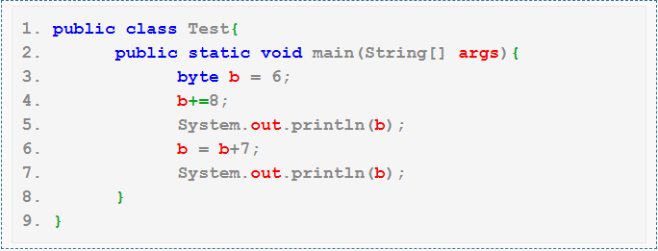
Q30
A. 14 21
B. 14 13
C. Compilation fails with an error at line 6
D. Compilation fails with an error at line 4

Slide 61
Q30
A. 14 21
B. 14 13
C. Compilation fails with an error at line 6
D. Compilation fails with an error at line 4

Slide 62
Q31
Which of these keywords is used to manually throw an exception?
a) throws
b) finally
c) throw
d) catch

Slide 63
Q31
Which of these keywords is used to manually throw an exception?
a) throws
b) finally
c) throw
d) catch

Slide 64
Q32
Which part of code gets executed whether exception is caught or not?
a) finally
b) try
c) catch
d) throw

Slide 65
Q32
Which part of code gets executed whether exception is caught or not?
a) finally
b) try
c) catch
d) throw

Slide 66
Q33
Which of the following handles the exception when a catch is not used?
a) finally
b) throw handler
c) default handler
d) java run time system

Slide 67
Q33
Which of the following handles the exception when a catch is not used?
a) finally
b) throw handler
c) default handler
d) java run time system

Slide 68
Q34
What will be the output of the following Java program?
import java.io.*;
class filesinputoutput
{
public static void main(String args[])
{
InputStream obj = new FileInputStream("inputoutput.java");
System.out.print(obj.available());
}
}
Note: inputoutput.java is stored in the disk.
a) true
b) false
c) prints number of bytes in file
d) prints number of characters in the file

Slide 69
Q34
What will be the output of the following Java program?
import java.io.*;
class filesinputoutput
{
public static void main(String args[])
{
InputStream obj = new FileInputStream("inputoutput.java");
System.out.print(obj.available());
}
}
Note: inputoutput.java is stored in the disk.
a) true
b) false
c) prints number of bytes in file
d) prints number of characters in the file

Slide 70
Q35
What will be the output of the following Java code?
import java.io.*;
class files
{
public static void main(String args[])
{
File obj = new File("/java/system");
System.out.print(obj.getName());
}
}
a) java
b) system
c) java/system
d) /java/system

Slide 71
Q35
What will be the output of the following Java code?
import java.io.*;
class files
{
public static void main(String args[])
{
File obj = new File("/java/system");
System.out.print(obj.getName());
}
}
a) java
b) system
c) java/system
d) /java/system

Slide 72
Q36
What will happen when you compile and run the following code with assertion enabled?
public class Test{
public static void main(String[] args){
int age = 20;
assert age > 20 : getMessage();
System.out.println("Valid");
}
private static void getMessage() {
System.out.println("Not valid");
}
}
A. The code will not compile
B. The code will compile but will throw AssertionError when executed
C. The code will compile and print Not Valid
D. The code will compile and print Valid
Notes:
A. You can use a method call in the assert statement after colon (:) provided it returns a value. The method with return type void cannot be used as second expression in the assert statement. The program will give compilation error saying “Expression must return a value”.

Slide 73
Q36
What will happen when you compile and run the following code with assertion enabled?
public class Test{
public static void main(String[] args){
int age = 20;
assert age > 20 : getMessage();
System.out.println("Valid");
}
private static void getMessage() {
System.out.println("Not valid");
}
}
A. The code will not compile
B. The code will compile but will throw AssertionError when executed
C. The code will compile and print Not Valid
D. The code will compile and print Valid
Notes:
A. You can use a method call in the assert statement after colon (:) provided it returns a value. The method with return type void cannot be used as second expression in the assert statement. The program will give compilation error saying “Expression must return a value”.

Slide 74
Q37
What will happen when you compile and run the following code with assertion enabled?
public class Test{
public static void main(String[] args){
assert false;
System.out.println("True");
}
}
A. The code will not compile due to unreachable code since false is hard coded in assert statement
B. The code will compile but will throw AssertionError when executed
C. The code will compile and print true
D. None of the above
Notes:
B

Slide 75
Q37
What will happen when you compile and run the following code with assertion enabled?
public class Test{
public static void main(String[] args){
assert false;
System.out.println("True");
}
}
A. The code will not compile due to unreachable code since false is hard coded in assert statement
B. The code will compile but will throw AssertionError when executed
C. The code will compile and print true
D. None of the above
Notes:
B

Slide 76
Q38(Output??)
public class pqr{
public static void main(String[] args){
int i = 10;
int j = 24;
int k = 34;
assert i + j >= k : k--;
System.out.println(i + j + k);
}
}
67
68
Compiles fine but gives AssertionError
None of these
Notes:
B

Slide 77
Q38(Output??)
public class pqr{
public static void main(String[] args){
int i = 10;
int j = 24;
int k = 34;
assert i + j >= k : k--;
System.out.println(i + j + k);
}
}
67
68
Compiles fine but gives AssertionError
None of these
Notes:
B

Slide 78
Q39(Output??)
What will be the output of the program?
public class Test
{
public static void main(String[] args)
{
int x = 0;
assert (x > 0) : "assertion failed"; /* Line 6 */
System.out.println("finished");
}
}
[A] finished
[B] Compilation fails.
[C] An AssertionError is thrown.
[D] An AssertionError is thrown and finished is output.
Notes:
C

Slide 79
Q39(Output??)
What will be the output of the program?
public class Test
{
public static void main(String[] args)
{
int x = 0;
assert (x > 0) : "assertion failed"; /* Line 6 */
System.out.println("finished");
}
}
[A] finished
[B] Compilation fails.
[C] An AssertionError is thrown.
[D] An AssertionError is thrown and finished is output.
Notes:
C

Slide 80
Q40
Output?
public class Test{
public static void main(String[] args){
boolean b = false;
assert b = true;
System.out.println("Hi");
}
}
Hi
The code will not compile
The code will compile but will throw AssertionError when executed
None of these
Notes:
A

Slide 81
Q40
Output?
public class Test{
public static void main(String[] args){
boolean b = false;
assert b = true;
System.out.println("Hi");
}
}
Hi
The code will not compile
The code will compile but will throw AssertionError when executed
None of these
Notes:
A

